Slide 1
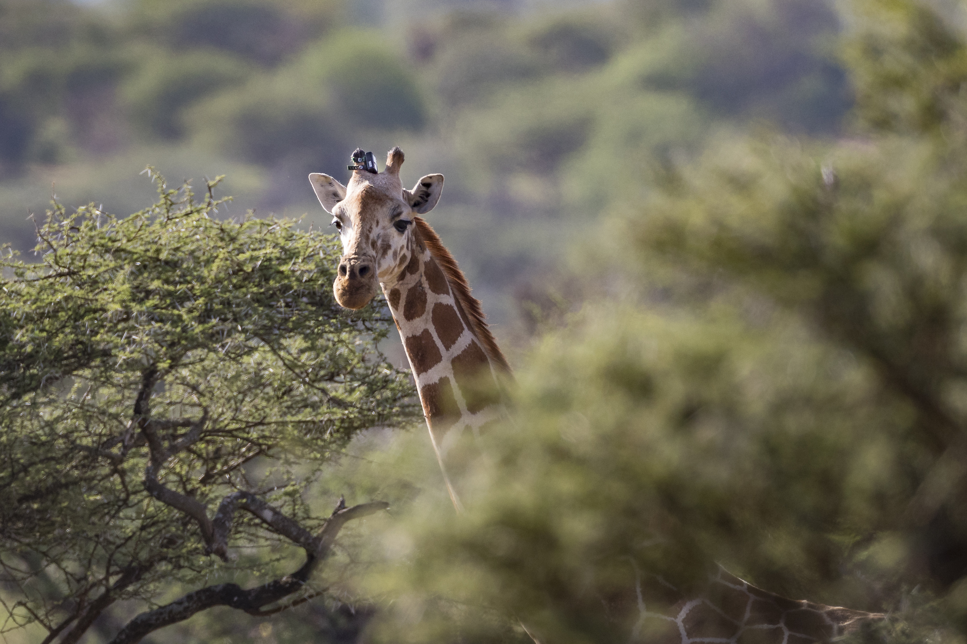
Week 5: Introduction to Animal Movement Analyses in R
Lecture: Tuesday, 13 April 2021 and Thursday, 15 April 2021
8:30 am – 10:20 pm EDT
Instructor:
Jared Stabach (StabachJ@si.edu)

Slide 2
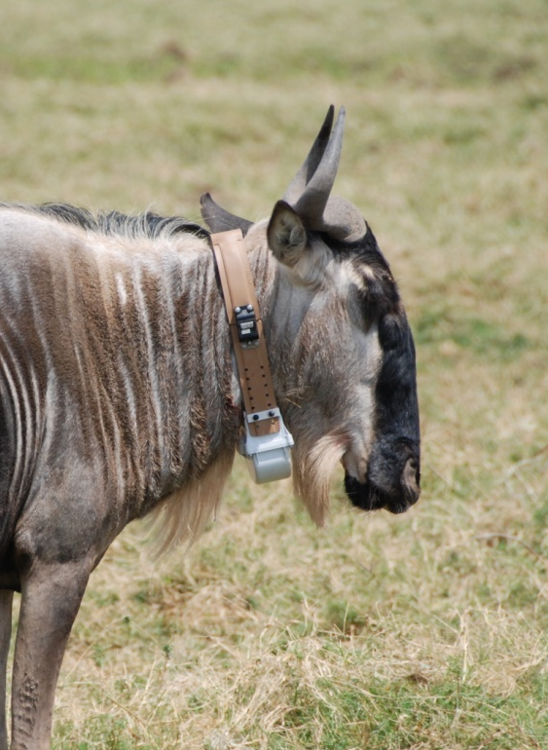
Week 5: Introduction to Movement Analyses
Lecture: Tuesday, 06 April 2021 and Thursday, 08 April 2021
8:30 am – 10:20 pm EDT
Tuesday
Data Import & Cleaning
Time Stamp Formatting
Duplicate Removal
Assessing Model Assumptions
Filtering Start Dates
Assessing Data Quality
Calculating Fix Success
Data Visualization
Animating Animal Movements (Super Fun!)
We will use GPS collar data, collected on white-bearded wildebeest (Connochaetes taurinus) during my doctoral work from 2010-2013 for all exercises. Methods, however, should be broadly applicable to other taxa.
Instructor:
Jared Stabach (StabachJ@si.edu)

Slide 3
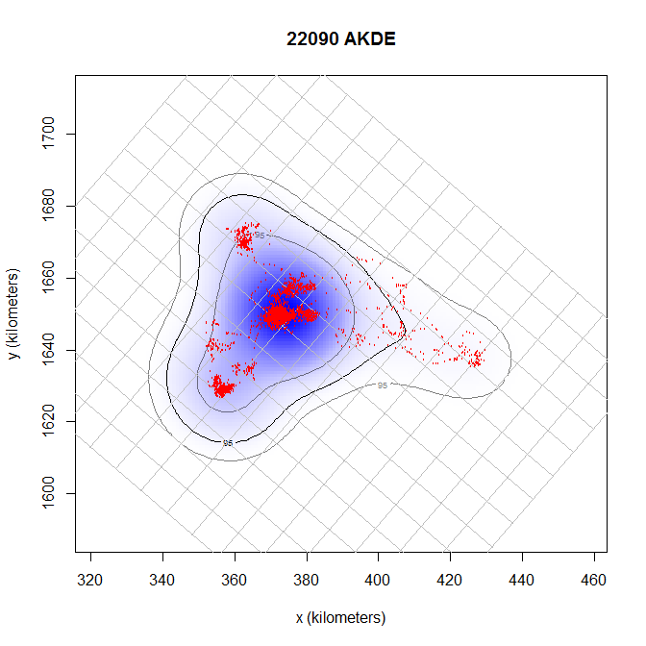
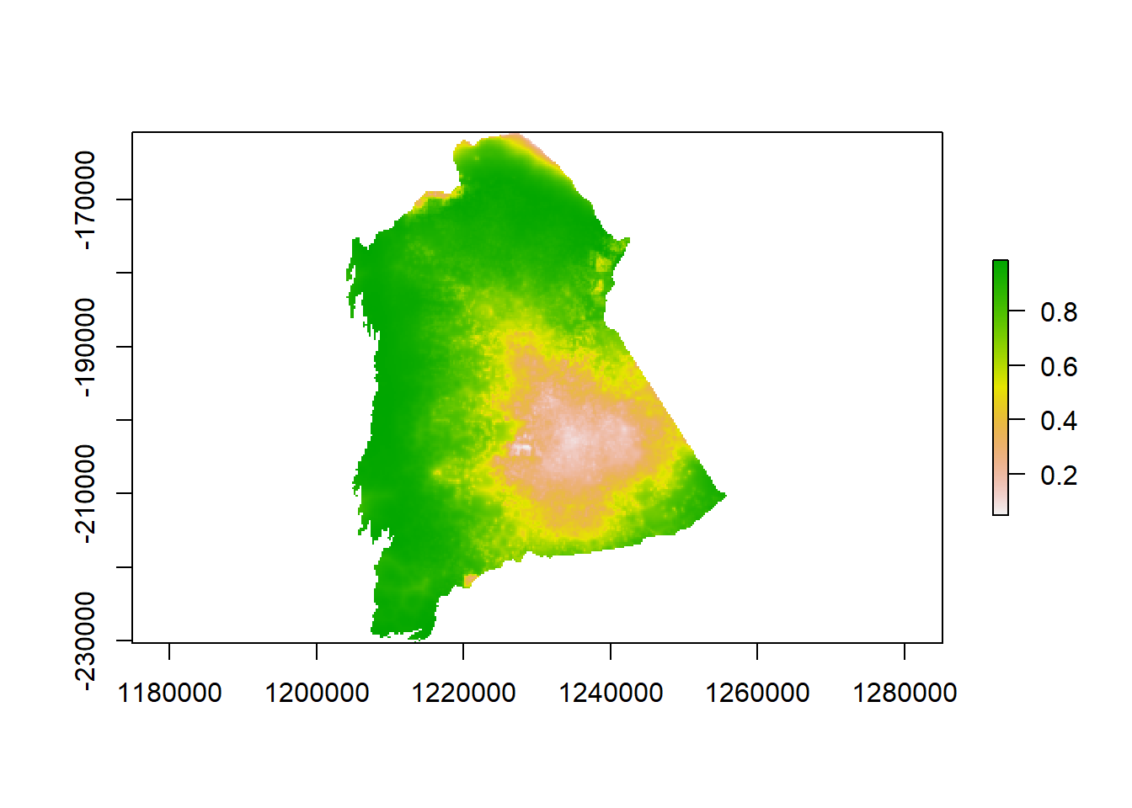
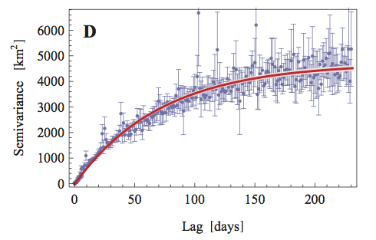
Week 5: Introduction to Movement Analyses
Lecture: Tuesday, 06 April 2021 and Thursday, 08 April 2021
8:30 am – 10:20 pm EDT
Thursday
Calculate Home Range
Minimum Convex Polygon (MCP)
Autocorrelated Kernel Density Estimation (AKDE)
Resource Selection Function (RSF) Analysis
‘Use’ vs ‘Availability’ design
Define ‘Availability;
Create spatial database
Perform logistic regression
Assess response curves
Generate a prediction map
Cracking the code
Instructor:
Jared Stabach (StabachJ@si.edu)

Slide 4
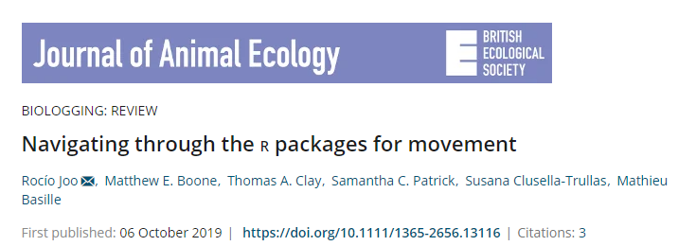
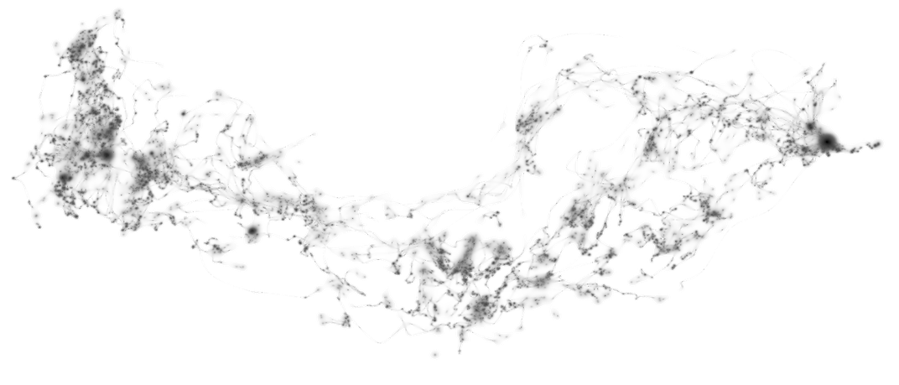
At least 58 packages in R to analyze animal tracking data
How to know which to use?

Slide 5
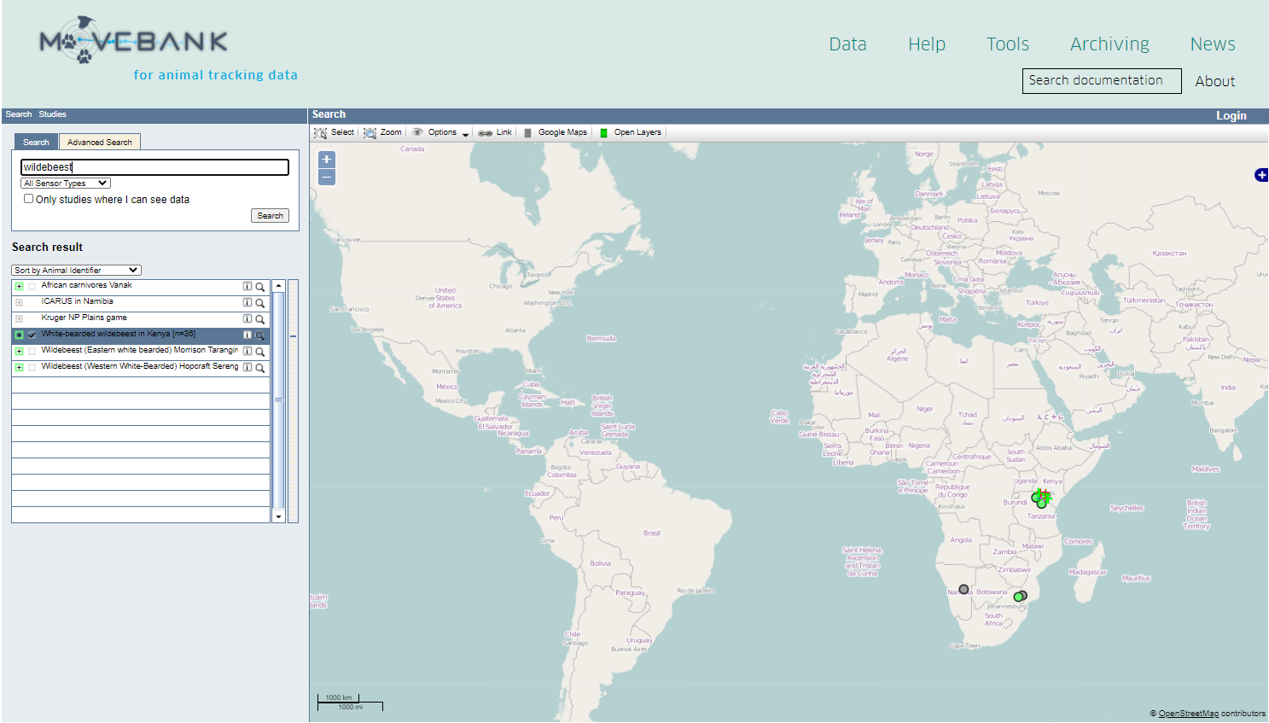
Where to get data…………
2.4 billion locations
5,915 studies
1,025 taxa
3,000 data owners

Slide 6
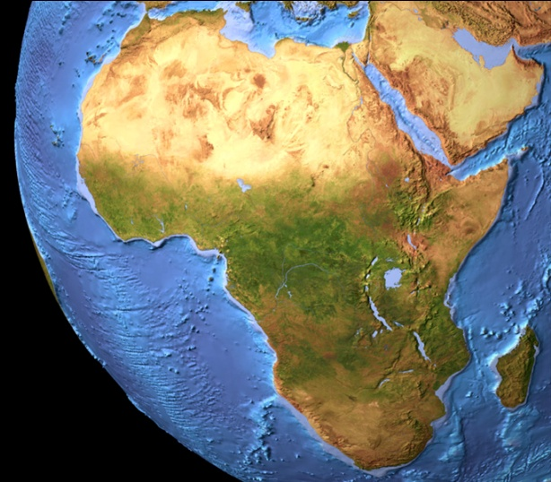
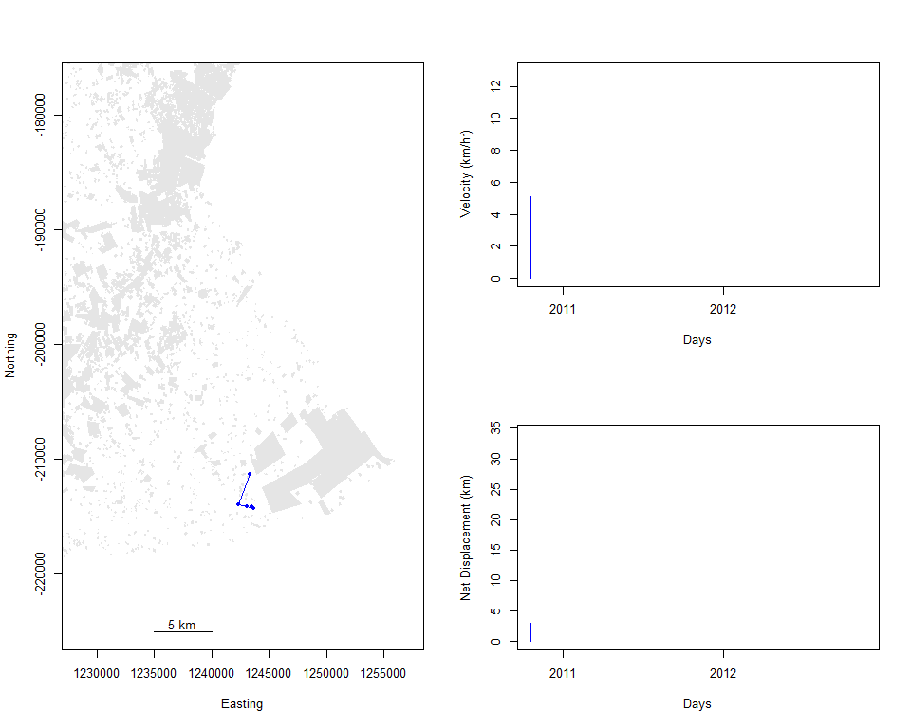
Visualize Movement Data
White-bearded wildebeest (Connochaetes taurinus)

Slide 7
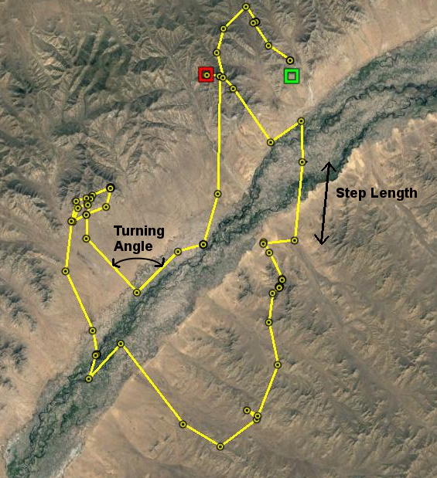
Properties of a Movement Path
Step length
Turning angle
Velocity
Autocorrelation

Slide 8
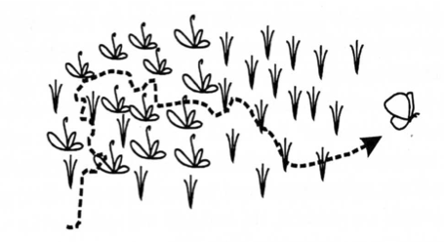
Things to be wary of
Different sampling rates give different answers

Slide 9
Home Range
Burt (1943): the area occupied by an individual during normal everyday activities (i.e., mating, feeding, carrying for young)
A home range must contains all the necessary resources to insure survival and reproduction
Spatial expression of behaviors animals perform to survive and reproduce
(Borger et al. 2008)

Slide 10
Home Range Characteristics
Individual spends majority of time here
Vary in size
Gender
Seasonally
By region/habitat
Irregular shape
Increase in size over time, but should asymptote (resident assumption)
Successful individual will have a high quality home range

Slide 11
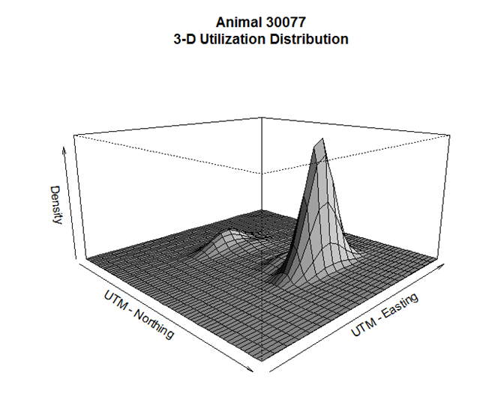
Multiple Home Range Estimators Exist
Minimum Convex Polygons
Harmonic Means
Jennrich Turner
Kernel Density
Brownian Bridge Kernel
Random Bridge Kernel
Local Convex Hull (LoCoH)
Characteristic Hull
…………..
All of these methods assume that data are IID
(Independent and Identically Distributed)

Slide 12
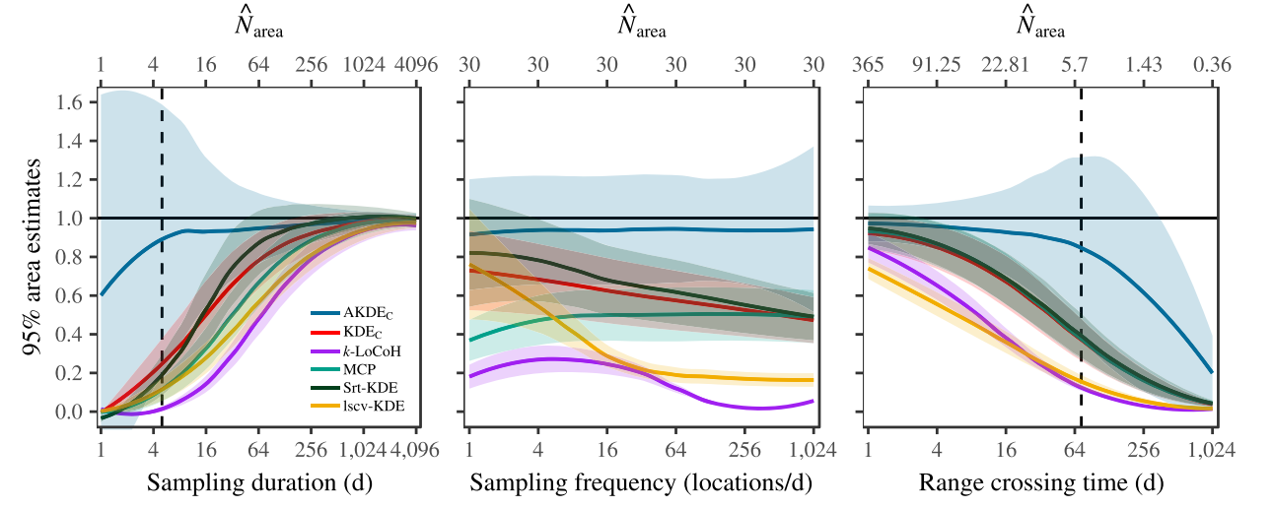
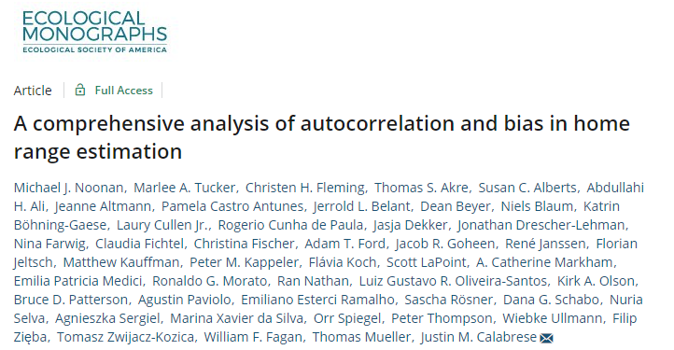
Quantitative Assessment of Home Range Estimators
MICHAEL J. NOONAN; MARLEE A. TUCKER; CHRISTEN H. FLEMING; THOMAS S. AKRE; SUSAN C. ALBERTS; ABDULLAHI H. ALI; JEANNE ALTMANN; PAMELA CASTRO ANTUNES; JERROLD L. BELANT; DEAN BEYER; NIELS BLAUM KATRIN B€OHNING-GAESE; LAURYCULLEN JR.; ROGERIO CUNHA DE PAULA; JASJA DEKKER; JONATHAN DRESCHER-LEHMAN; NINA FARWIG; CLAUDIA FICHTEL; CHRISTINA FISCHER; ADAM T. FORD; JACOB R. GOHEEN; RENE JANSSEN; FLORIAN JELTSCH; MATTHEW KAUFFMAN; PETER M. KAPPELER; FLAVIA KOCH; SCOTT LAPOINT; A. CATHERINE MARKHAM; EMILIA PATRICIA MEDICI; RONALDO G. MORATO; RAN NATHAN; LUIZ GUSTAVO R. OLIVEIRA-SANTOS; KIRK A. OLSON; BRUCE D. PATTERSON; AGUSTIN PAVIOLO; EMILIANO ESTERCI RAMALHO; SASCHA R€OSNER; DANA G. SCHABO; NURIA SELVA; AGNIESZKA SERGIEL; MARINA XAVIER DA SILVA; ORR SPIEGEL; PETER THOMPSON; WIEBKE ULLMANN; FILIP ZIEz BA; TOMASZ ZWIJACZ-KOZICA WILLIAM F. FAGAN; THOMAS MUELLER; AND JUSTIN M. CALABRESE

Slide 13
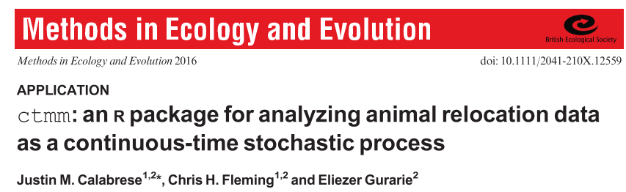
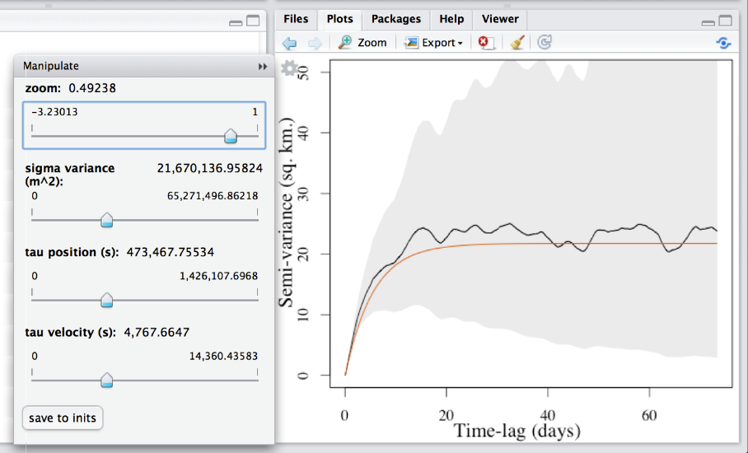
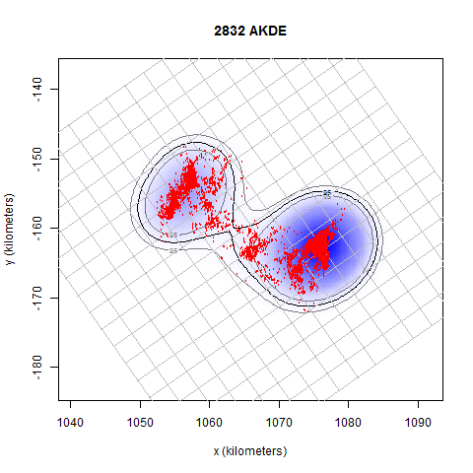
Home Range
Continuous-Time Movement Modeling (CTMM) Framework
Visual diagnostics
Model selection (AIC)
Home range estimation
Path reconstruction
Occurrence distribution

Slide 14
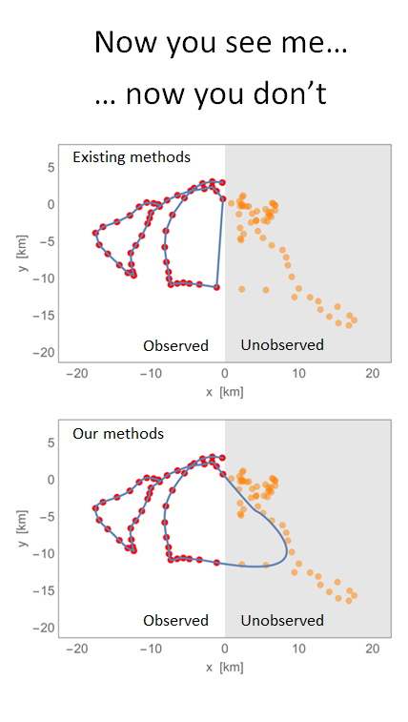
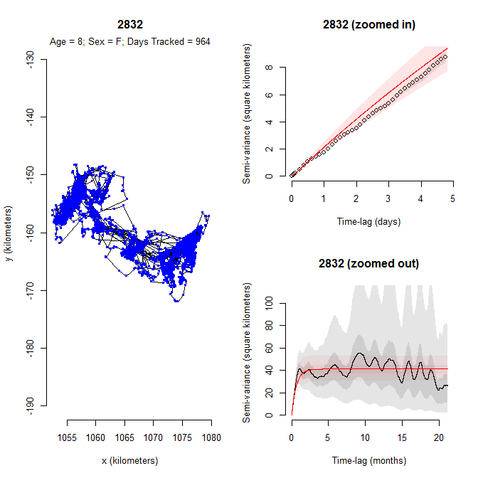
Home Range
Continuous-Time Movement Modeling (CTMM) Framework
Incorporate autocorrelation structure
Insensitive to irregular sampling/data gaps
Candidate model evaluation (AIC)
Quantitatively evaluate range residency
Observed to outperform previous methods
(MCP, KDE, LoCoH)
Confidence interval estimation
Conservation implications
Notes:
IID – Independent and Identically Distributed Data

Slide 15
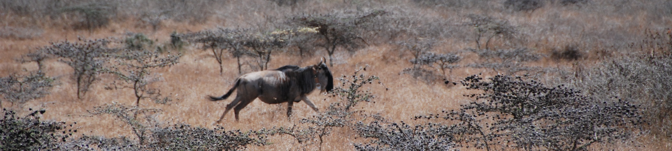
Resource Selection Function Analysis
Describe the relationship between an animal and its environment
Point Process Model: Points Instead of Paths – A first step
Does the animal use a habitat type more than expected by random
Positive response – Animal prefers habitat type
Negative response – Animal avoids habitat type
©AP

Slide 16
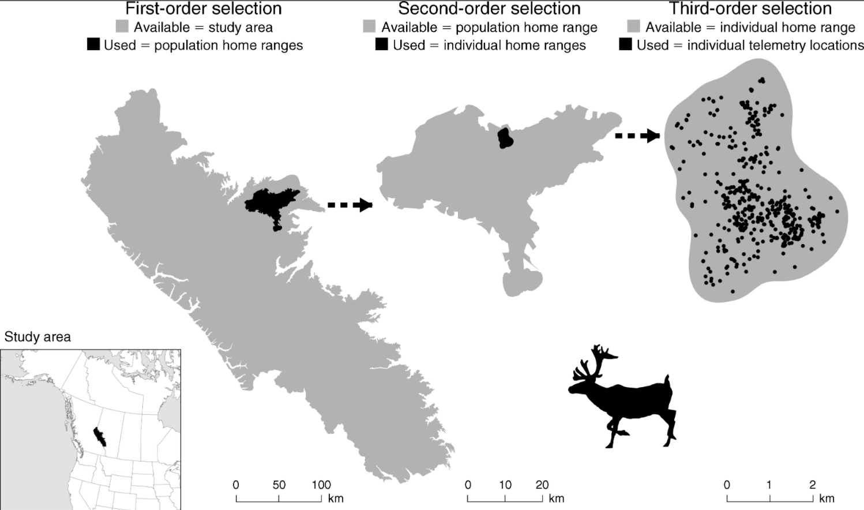
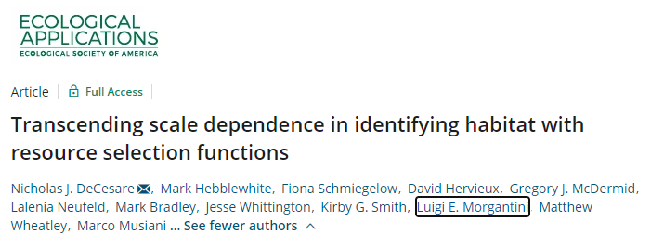
Orders of Selection – Different scales of inference
Johnson, D. 1980. The comparison of usage and availability measurements for evaluating resource preference. Ecology 61:65-71.
Fourth-order selection: Local habitat selection (individual steps)

Slide 17
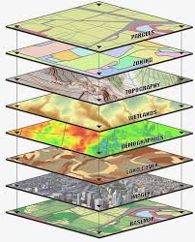
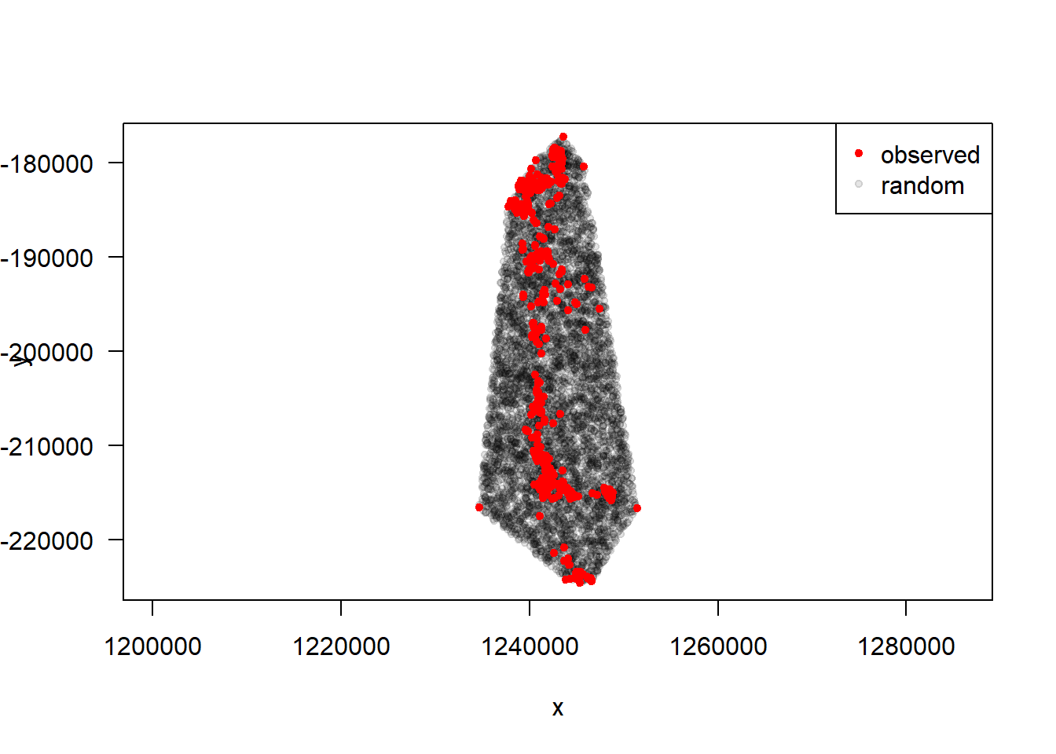
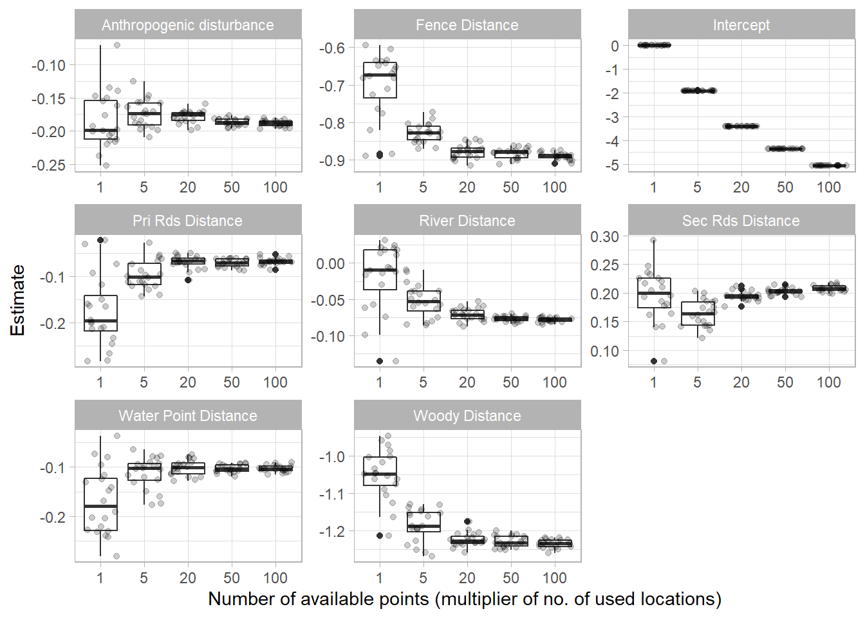
Use v. Availability Study Design
Logistic regression analysis
w(x, β)=exp(β₁x₁+ β₂x₂+ ⋯+β_{n}x_{n})
Extract
Values
Habitat covariates:
Anthropogenic Footprint
Distance to landscape features (Roads, Rivers)
……
Simulation analysis required to estimate required availability sample

Slide 18
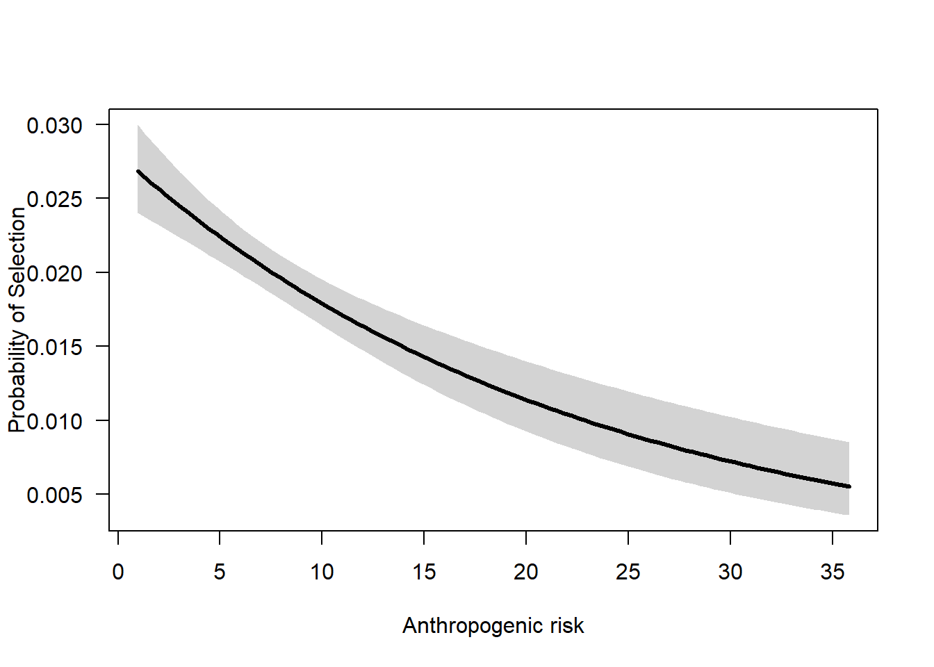
Use v. Availability Study Design
Logistic regression analysis
w(x, β)=exp(β₁x₁+ β₂x₂+ ⋯+β_{n}x_{n})
Habitat covariates:
Anthropogenic Footprint
Distance to landscape features (Roads, Rivers)
……

Slide 19
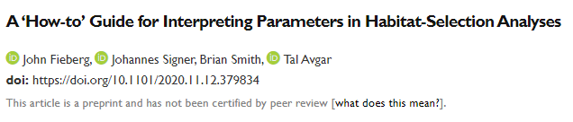
Resource Selection Function Analysis
Final Prediction
For more information:

